Slide 1
The String Type
The char type only represents one character. To represent a string of characters, use the data type called String. For example,
String message = "Welcome to Java";
String is actually a predefined class in the Java library just like the System class and Scanner class. The String type is not a primitive type. It is known as a reference type. Any Java class can be used as a reference type for a variable.

Slide 2
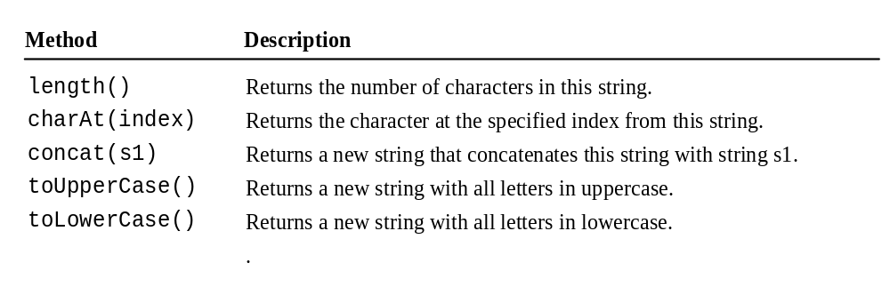
Simple Methods for String Objects

Slide 3
Simple Methods for String Objects
Strings are objects in Java. The methods in the preceding table can only be invoked from a specific string instance. For this reason, these methods are called instance methods. A non-instance method is called a static method. A static method can be invoked without using an object. All the methods defined in the Math class are static methods. They are not tied to a specific object instance. The syntax to invoke an instance method is
referenceVariable.methodName(arguments).

Slide 4
Getting String Length
String message = "Welcome to Java";
System.out.println("The length of " + message + " is "
+ message.length());

Slide 5
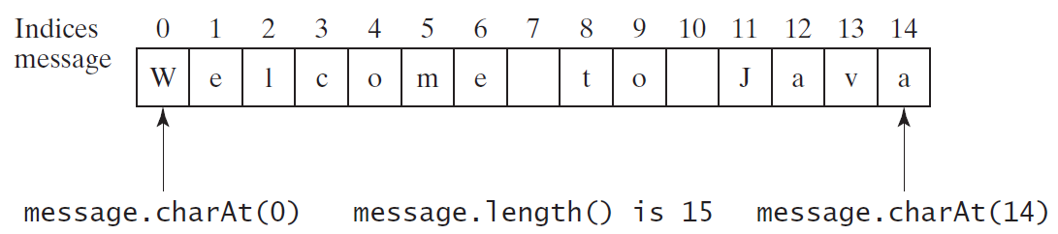
Getting Characters from a String
String message = "Welcome to Java";
System.out.println("The first character in message is "
+ message.charAt(0));

Slide 6
Converting Strings
"Welcome".toLowerCase() returns a new string, welcome.
"Welcome".toUpperCase() returns a new string, WELCOME.

Slide 7
String Concatenation
String s3 = s1.concat(s2); or String s3 = s1 + s2;
// Three strings are concatenated
String message = "Welcome " + "to " + "Java";
// String Chapter is concatenated with number 2
String s = "Chapter" + 2; // s becomes Chapter2
// String Supplement is concatenated with character B
String s1 = "Supplement" + 'B'; // s1 becomes SupplementB

Slide 8
Reading a String from the Console
Scanner input = new Scanner(System.in);
System.out.println("Enter single line ");
String s1 = input.nextLine();
System.out.println(s1);

Slide 9
Reading a String from the Console
Scanner input = new Scanner(System.in);
System.out.print("Enter three words separated by spaces: ");
String s1 = input.next();
String s2 = input.next();
String s3 = input.next();
System.out.println("s1 is " + s1);
System.out.println("s2 is " + s2);
System.out.println("s3 is " + s3);

Slide 10
Reading a String line from the Console
Scanner input = new Scanner(System.in);
System.out.println("Enter single line ");
String s1 = input.nextLine();
//nextLine will be ended with the enter key whereas next() method will take the word which will be ended with space;

Slide 11
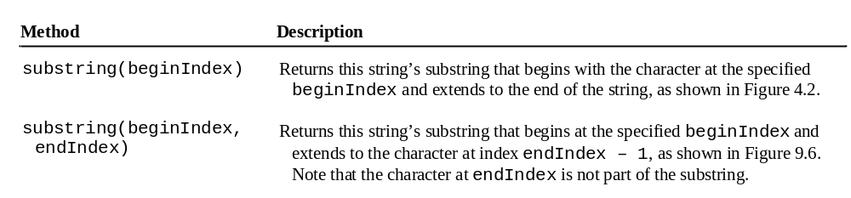
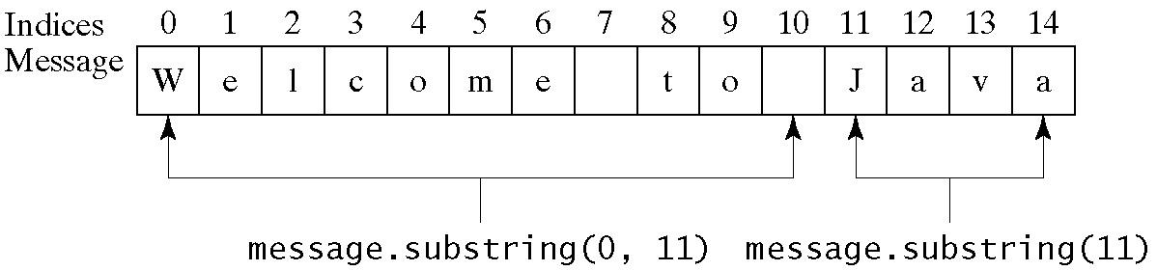
Obtaining Substrings

Slide 12
Conversion between Strings and Numbers
int intValue = Integer.parseInt(intString);
double doubleValue = Double.parseDouble(doubleString);
String s = number + "";

Slide 13
Formatting Output
Use the printf statement.
  System.out.printf(format, items);
Where format is a string that may consist of substrings and format specifiers. A format specifier specifies how an item should be displayed. An item may be a numeric value, character, boolean value, or a string. Each specifier begins with a percent sign.

Slide 14

Frequently-Used Specifiers
Specifier Output Example
%c a character 'a'
%d a decimal integer 200
%f a floating-point number 45.460000
%s a string "Java is cool"

